Slide 1
Cybersecurity
WPS Attacks

Slide 2
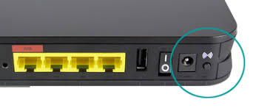

Using WPS
Wi-Fi Protected Setup
Provides easy setup for joining a device to a network
Different ways to connect:
Push a button on the access point
Enter a PIN on access point into device
Near-field communication (NFC) – bring the mobile device close to access point

Slide 3


Hacking WPS
PIN is an eight-digit number
7+1, seven digits followed by a checksum digit
Seven digits = 10,000,000 possible combinations
8th digit is computed based on first 7 digits
WPS validates the PIN in halves
First half: 4 digits (10,000 possibilities: 0000-9999)
Second half: 3 digits (1,000 possibilities: 000-999)
Total number of guesses is 11,000 (much less than the original 10,000,000 combinations!)
Automated process will cycle through all 11,000 possible combinations in under 4 hours.

Slide 4

Protecting WPS PIN
Attacker only needs 11,000 possible guesses
(4 hours may seem like a long time, but a determined hacker can setup a device and walk away, come back later after it’s cracked it.)
Slow down the amount of time between entries
Not often a legitimate user will enter wrong PIN multiple times
More wrong guesses = increased delay between PIN entries
Make hack take from 4 hours to hundreds or thousands of hours
Intrusion Protection System should alert to too many bad PIN attempts

Slide 5
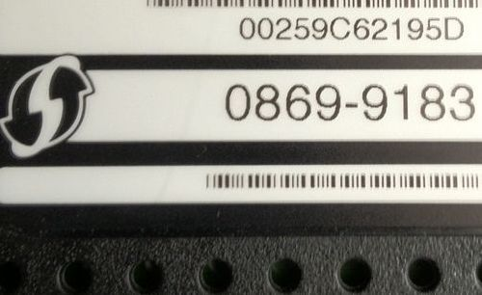
Protecting WPS
Pushbutton allows any device to join the network
Physically protect router or access point
Do not allow unauthorized users to press the button
Better: Disable the WPS pushbutton!
WPS PIN may be visible on the access point
DO NOT keep the default PIN
Hide the PIN, keep it out of sight
WPS PIN

Slide 6
Other WPS Attacks
Offline WPS PIN attack
Some chipset manufacturers did not generate true random numbers for generating hashes to encrypt the “WPS Setup”
Attack known as Pixie Dust uses probable hash values to bypass WPS PIN guessing. This is done “offline” and does not hammer the access point.
PIN attempt slowdowns are useless to this attack
Cracks faster than 4 hours – usually in seconds or minutes!
Protecting from this? Disable WPS altogether. Don’t use it!

